Slide 1




SPARK Hand: Scooping-Pinching Adaptive Robotic Hand
with Kempe Mechanism for Vertical Passive Grasp
in Environmental Constraints
Jiaqi Yin, Tianyi Bi, Wenzeng Zhang, Member, IEEE
Harbin Institute of Technology
Southern University of Science and Technology
Shenzhen X-Institute
Notes:
Good afternoon. I’m Jiaqi Yin from Harbin Institute of Technology, presenting joint work with Tianyi Bi and Wenzeng Zhang from Southern University of Science and Technology and Shenzhen X-Institute.

Slide 2
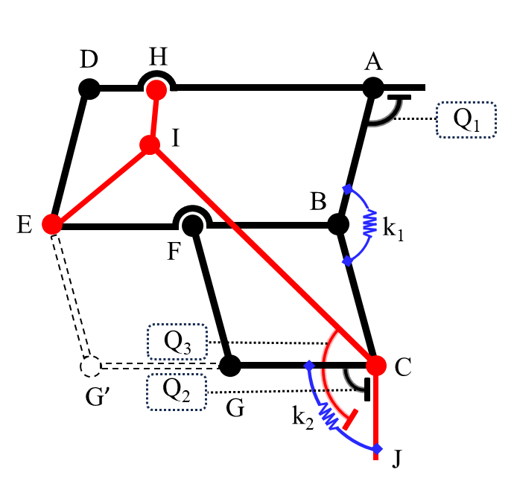
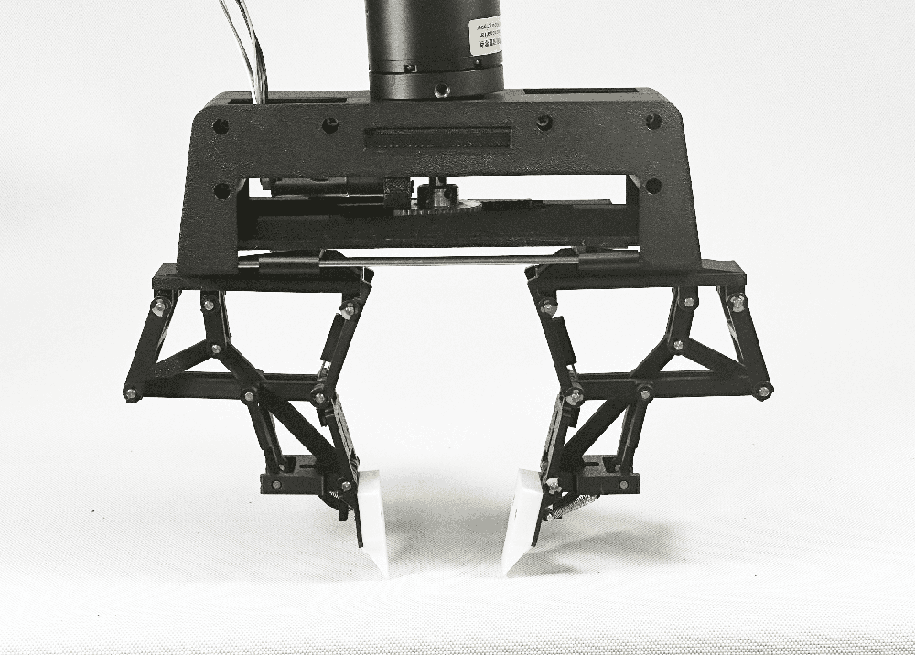
Motivations
Thin or flat objects on a surface are difficult to grasp with conventional grippers—so we build a hand that passively adapts to contact with the environment to pinch small items or scoop from the surface.
The SPARK Hand
Mechanism Overview
Key Mechanism: Modified Kempe straight-line + parallelogram linkage → vertical, orientation-fixed fingertip.
Passive Adaptation: Springs (k₁, k₂) + stoppers (Q₁–Q₃) auto-switch Pinch↔Scoop on contact.
Simplicity: Single linear actuator, underactuated; no extra motors for mode switching → lower complexity/cost.
Notes:
Grasping is fundamental in robotics, yet a stubborn failure case remains: thin or flat objects lying on a table. With limited contact area and tight surface interaction, even a simple card or coin can defeat conventional parallel grippers. Underactuated compliant hands help with shape variation, but in these constrained settings they often slip or lack precision.
Humans solve this in two ways: we either pinch the edge or slide a fingertip under in a scooping motion. That observation motivates our goal: a hand that passively adapts to the surface and can transition between pinching and scooping without added complexity.
This is the idea behind the SPARK Hand—a simple passive mechanism designed to turn a worst-case scenario into a routine grasp.

Slide 3
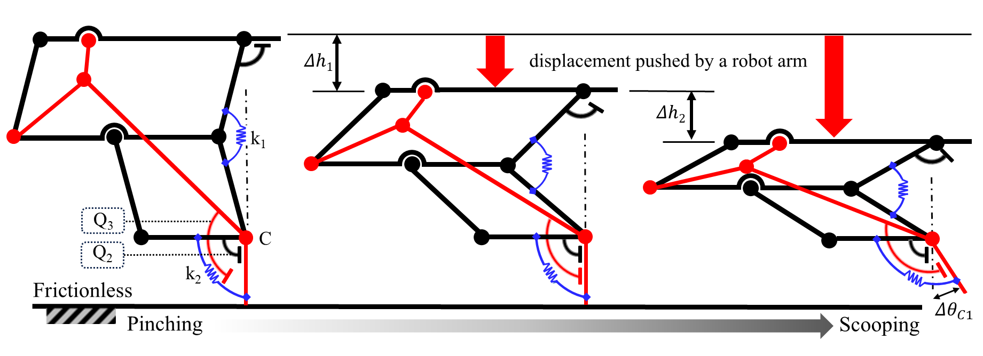
Design of SPARK Hand
Passive mode switching
Vertical path: Kempe + parallelogram → purely vertical fingertip motion, ≈0 lateral drift.
Pinch: Surface contact → Q₂ locks distal link → parallel close (card/screw).
Symmetric scoop: Further pressing (Δh₁, Δh₂) compresses k₁/k₂ → distal links fold → both fingers slide under.
Asymmetric scoop: Tilt wrist → one finger supports, the other scoops from the side—ideal for wide/flat items.
Vertical path: Kempe + parallelogram → pure vertical fingertip, ~0 lateral drift.
Pinch: Table contact → Q2 locks distal link → parallel close (card/screw).
Symmetric scoop: Further press (Δh₁, Δh₂) → k₁/k₂ fold → both fingers slide under.
Asymmetric scoop: Tilted hand → one finger supports, the other scoops from the side (wide/flat items).
Notes:
Here is how the hand achieves that. Each finger combines a modified Kempe straight-line linkage with a parallelogram, so the fingertip moves straight vertically and its orientation stays fixed. No sideways sweep means uniform contact and no scratching.
Pinch (left panel): when the fingers touch the surface, stopper Q₂ locks the distal link; both fingers close in parallel for a precise pinch—reliable even on a thin card or a small screw.
Symmetric scoop (middle): with further pressing—first Δh₁, then Δh₂—springs k₁/k₂ compress and Q₃ engages, so the distal links fold by ΔθC1. Both fingers slide under and form a stable scoop.
Asymmetric scoop (right): a wrist tilt keeps one finger vertical as support while the other folds and scoops from the side, which is ideal for wide, flat items.
All of these transitions are fully passive—the environment triggers the switch; no extra actuators or sensors.

Slide 4
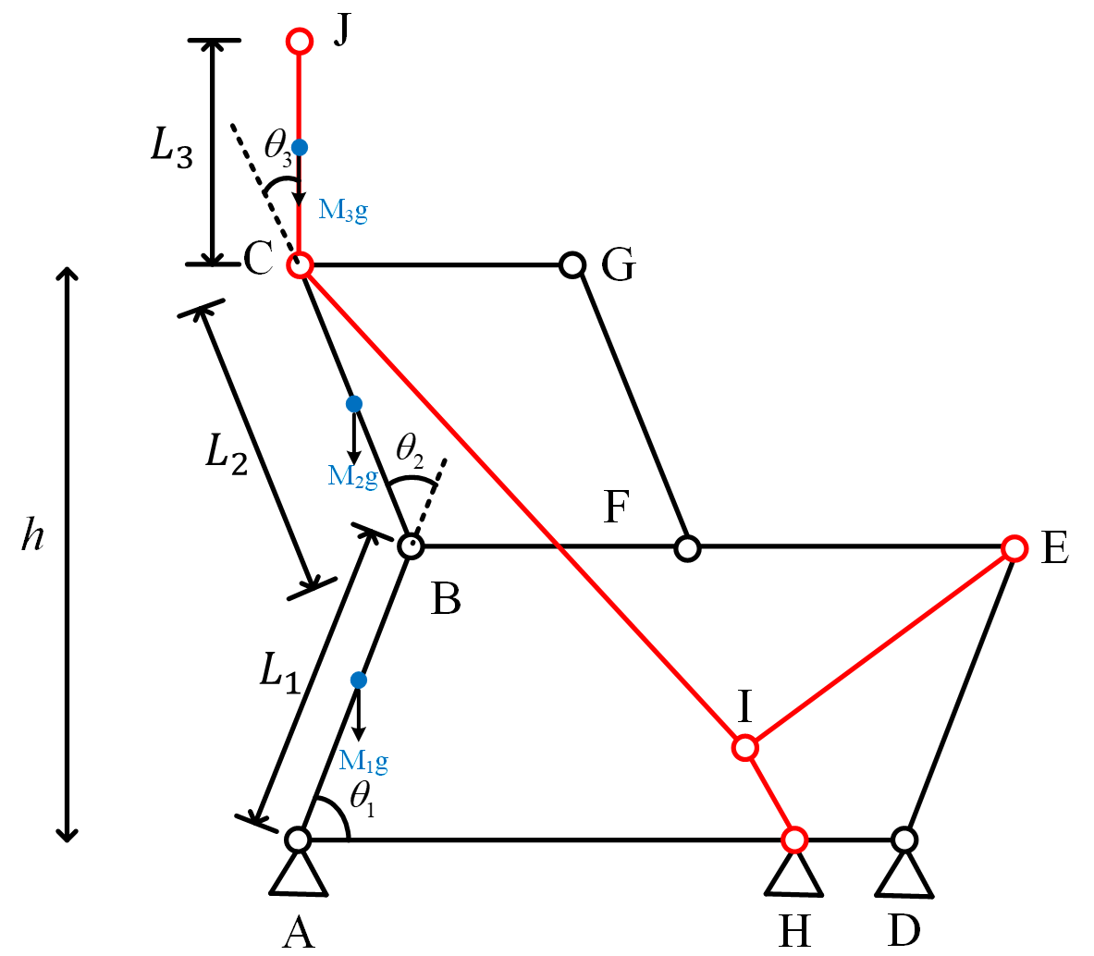
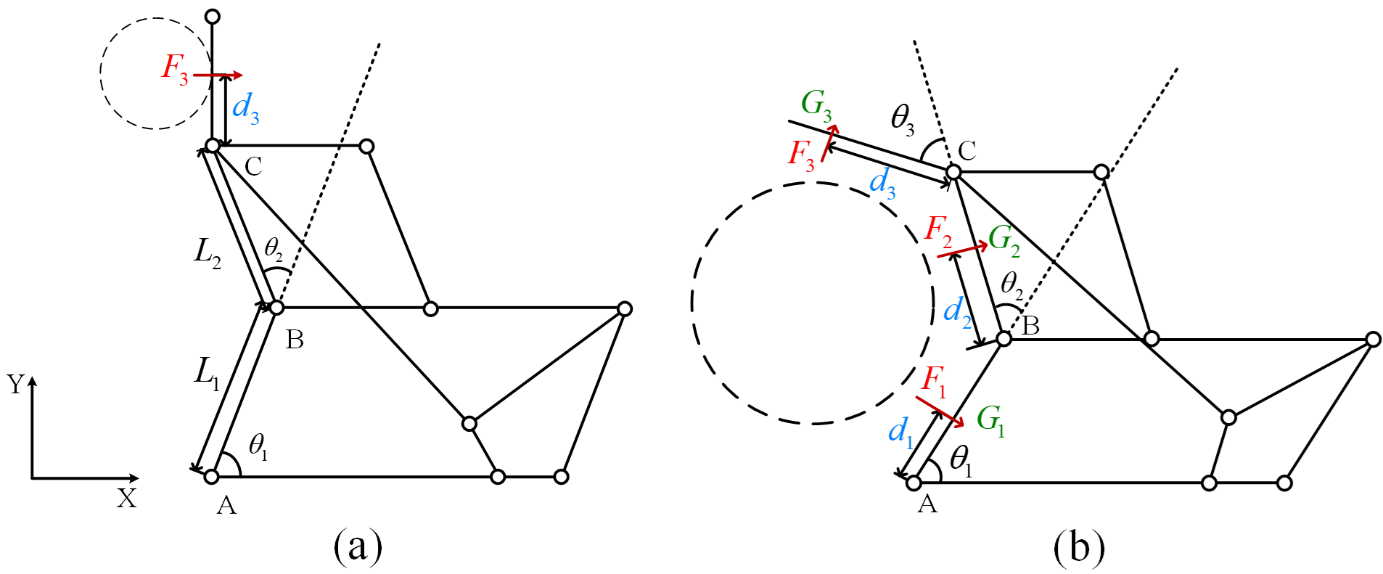
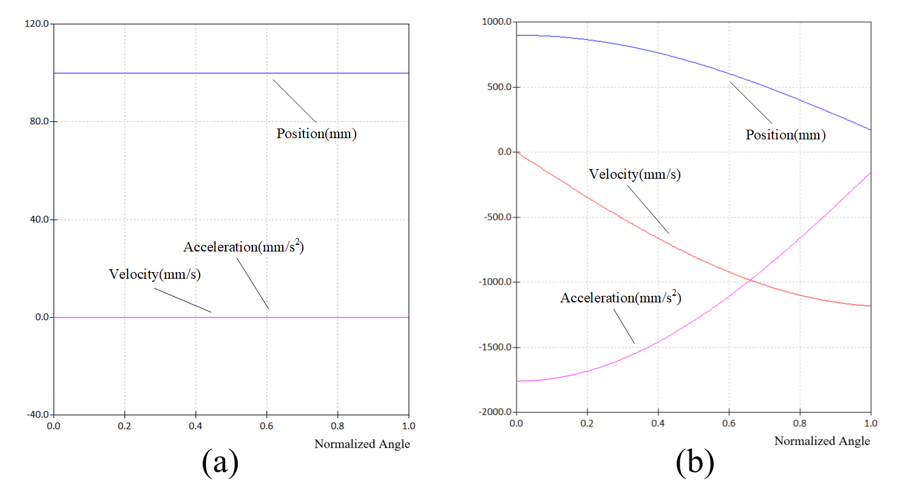
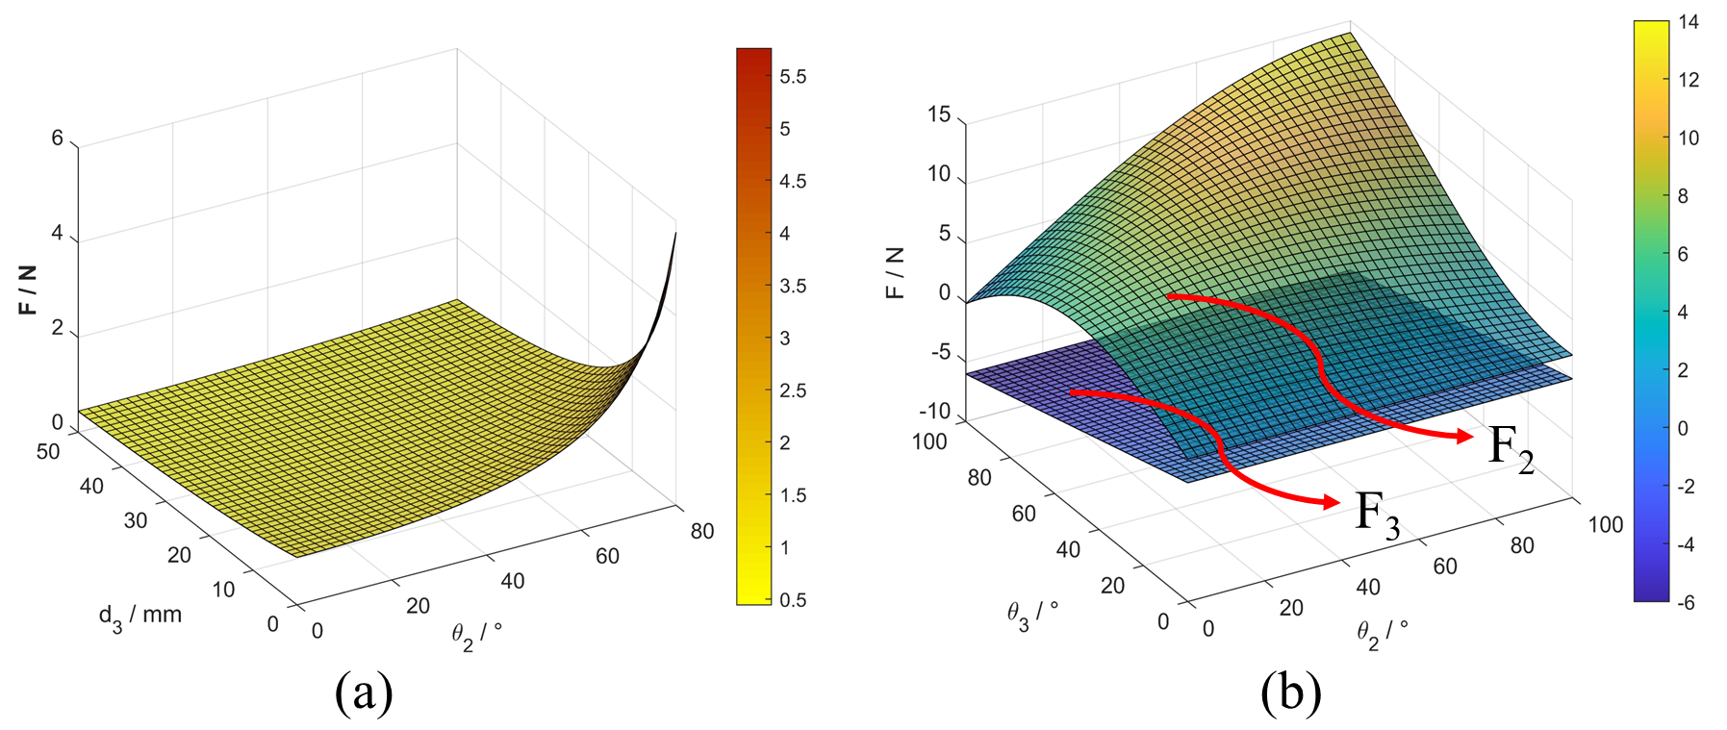
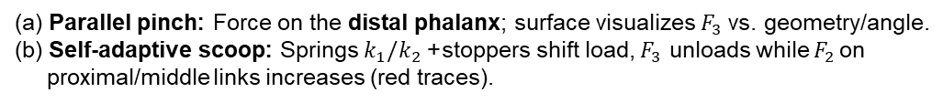
Kinematics & Forces
Mathematical Model
Hydrostatic model
3-link D–H model with transforms 𝐴𝑖​ and Jacobian 𝐽 defines fingertip kinematics. The 4:2:1 link ratio preserves a vertical path.
(a) Pinch: distal link bears load, $τ=F_{3}\left(d_{3}+L_{2}\cos{θ_{2}}\right)$.
(b) Scoop: springs/stoppers add counter-moment so the distal link disengages
Motion Characteristic
Grasping Force
Fingertip motion is purely vertical (y = 0)
with smooth position/velocity/acceleration; orientation remains fixed.
(a) Parallel pinch: Force on the distal phalanx; surface visualizes $F_{3}$vs. geometry/angle.
(b) Self-adaptive scoop: Springs $k_{1}/k_{2}$+ stoppers shift load, $F_{3}$ unloads while $F_{2 }$on
proximal/middle links increases (red traces).
Kinematics: Kempe + parallelogram → vertical, orientation-locked fingertip; D–H + 𝐽 confirm y=0 path and smooth motion.
Forces: Pinch: distal link bears force. Scoop: springs(k₁/k₂)/stoppers(Q₂/Q₃) shift load to proximal/middle links.
Implication: Passive force redistribution enables scratch-free slide-in, then lift in constrained spaces.
Notes:
Why does this switch work so reliably?
Top-left: we model one finger as a 3-link D–H chain; from the transforms and the Jacobian we obtain the fingertip trajectory.
Top-right: the motion characteristic shows a purely vertical path (y ≈ 0) with smooth position, velocity, and acceleration; orientation is locked.
Bottom-left: the hydrostatic model explains the modes. In pinch, the distal link bears the load under the torque balance $τ=F_{3}\left(d_{3}+L_{2}\cos{θ_{2}}\right)$. In scoop, springs and stoppers provide a counter-moment, so the distal link disengages.
Bottom-right: the grasping-force surfaces visualize what happens next: the load shifts from the distal link (pinch) to the proximal/middle links (scoop)—you can see $F_{3}$drop while $F_{2}$rises along the red traces.
This passive redistribution is what enables a clean slide-in, then lift in constrained on-table settings.

Slide 5
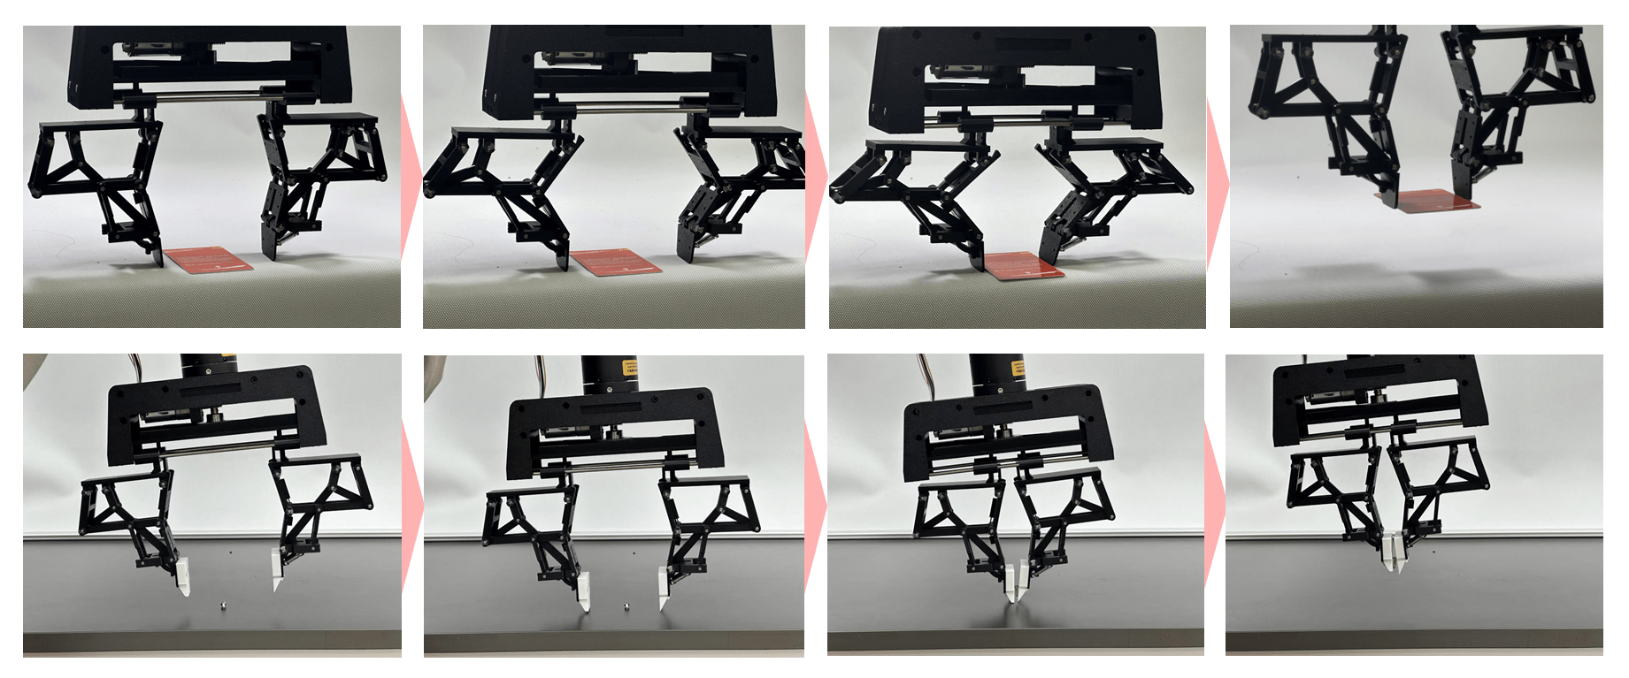

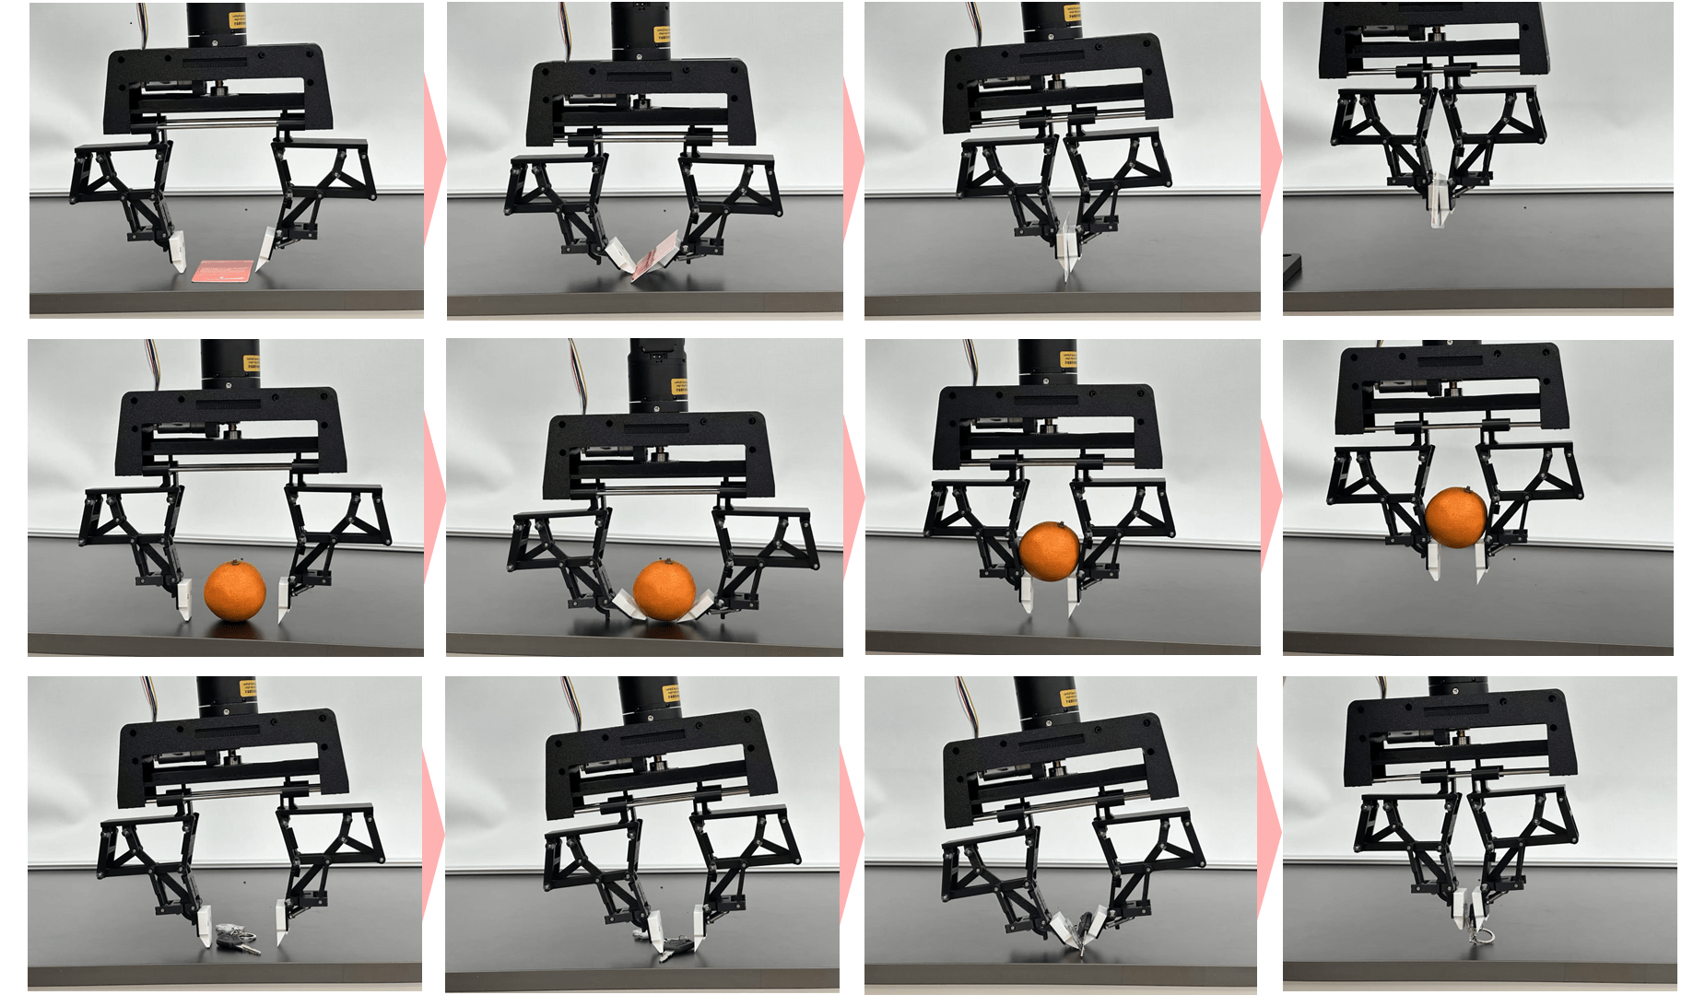
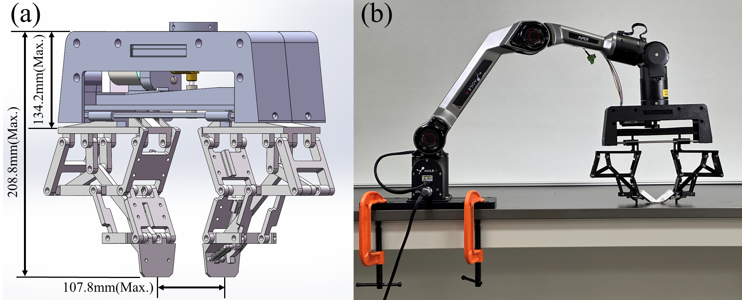
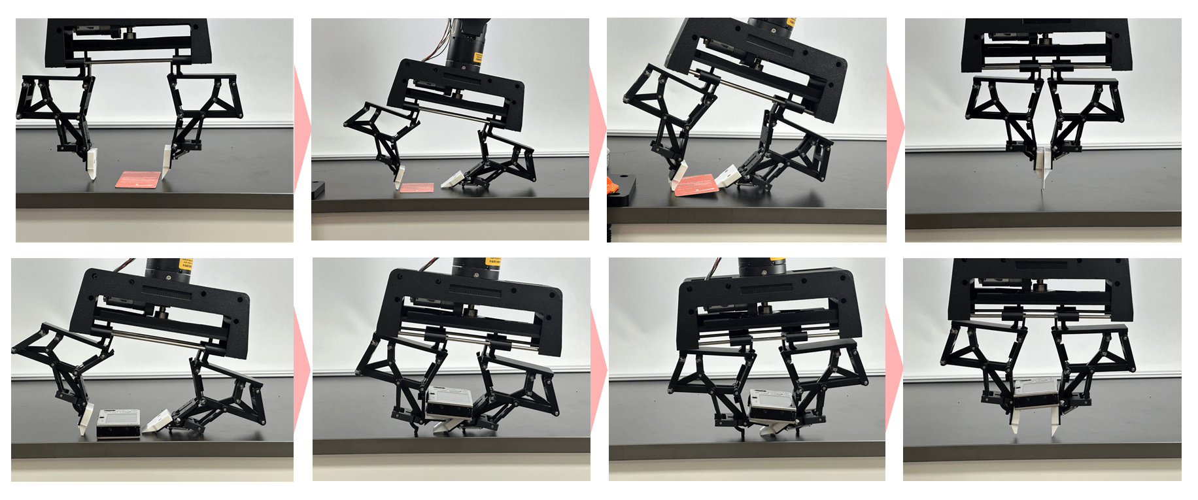
Experiments
Pinch
Tasks
Pinch: thin plastic card, small screw.
Symmetric scoop: card, orange, keychain (both fingers slide under).
Asymmetric scoop (wrist tilt): wide/flat items; one finger supports, the other scoops.
Symmetric Scoop
3D Model & Setup
Watch the video
Scan the QR for the full sequences.
(a) SPARK hand CAD (b) Test rig with a single linear actuator.
Asymmetric Scoop
Auto-switching: Environment contact triggers Pinch ↔ Scoop with no extra actuators or sensing.
On-table reliability: Slide-in → lift works for thin/flat items and curved objects in constrained setups.
Simplicity: Underactuated hardware, robust behavior, low complexity & cost.
Notes:
Now the experiments. On the left are the tasks and the rig—two identical SPARK fingers driven by one linear actuator; the QR links to the full demo.
On the right, three filmstrips summarize the results:
Pinch: surface contact → Q₂ locks → parallel clamp; we reliably lift a thin card and a small screw.
Symmetric Scoop: with further pressing, k₁/k₂ fold the distal links; both fingers slide under to lift a card, an orange, and a keychain.
Asymmetric Scoop: with wrist tilt, one finger supports vertically while the other scoops from the side, which works well for wide/flat items.
Across all tasks, the mode switch is passive—no extra motors or sensing—and the behavior is consistent.

Slide 6
Conclusion
What we built: A passive, underactuated two-finger hand whose modified Kempe straight-line linkage + parallelogram yields a vertical, orientation-locked fingertip—the foundation for reliable on-table interaction.
Key capability: Springs + stoppers provide automatic Pinch↔Scoop switching on surface contact, enabling pinching, symmetric scooping, and asymmetric (tilted) scooping without extra actuators or sensing.
Why it matters: The design directly addresses thin/flat objects in constrained setups, a failure case for many grippers, while keeping hardware simple, robust, and low-cost.
Evidence: Prototype studies show stable grasps of cards, small screws, a spherical orange, and an irregular keychain, validating passive mode-switching and on-table slide-in grasps.
Take-home message: Environmental compliance through mechanics—not control—lets a minimal hand slide-in, scoop, and lift the hard cases that conventional parallel grippers miss.
Limitations & Next Steps:
Add force/tactile sensing; tune linkage/spring parameters for payload & speed.
Durability / life-cycle tests; benchmark vs strong baselines on thin-object suites.
Extend to multi-finger hands and dynamic manipulation (integration with perception & planning)
Integrate force/tactile feedback, tune linkage/spring parameters for payload/speed, add durability tests, and benchmark against strong baselines on standardized thin-object suites; extend to multi-finger hands and dynamic manipulation.
Notes:
To conclude: we built a passive, underactuated two-finger hand. The modified Kempe linkage + parallelogram yields a vertical, orientation-locked fingertip—the foundation for reliable on-table interaction. Springs and stoppers enable automatic Pinch↔Scoop on contact with just one actuator.
This design directly addresses thin/flat objects in constrained setups, while staying simple, robust, and low-cost. In experiments we showed stable grasps of a card, small screw, orange, and keychain, validating slide-in → lift and passive mode-switching.
Next, we’ll add tactile sensing, tune linkage and springs for payload/speed, perform durability and benchmark studies, and extend to multi-finger, dynamic manipulation.
Thank you.

Slide 7
Thank You!

